Slide 1



Photographic Studio Manager
Website quản lý Studio.

Slide 2
CAPSTONE PROJECT PRESENTATION 卒業論文プレゼンテーション
Hanoi, May 10th, 2018

Slide 3
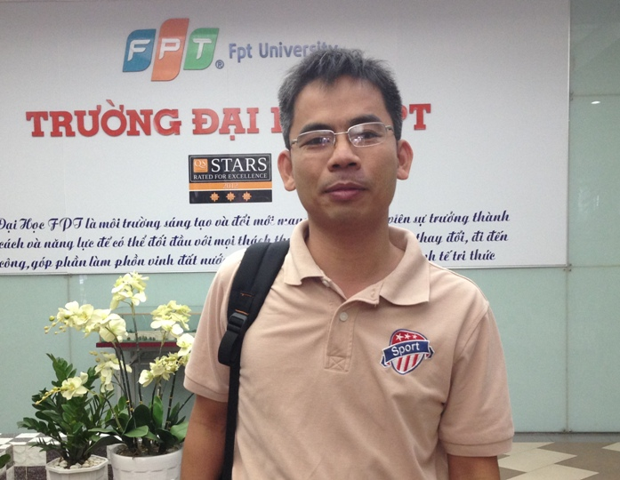

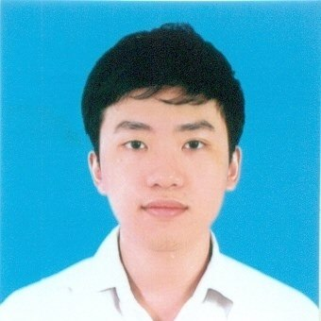
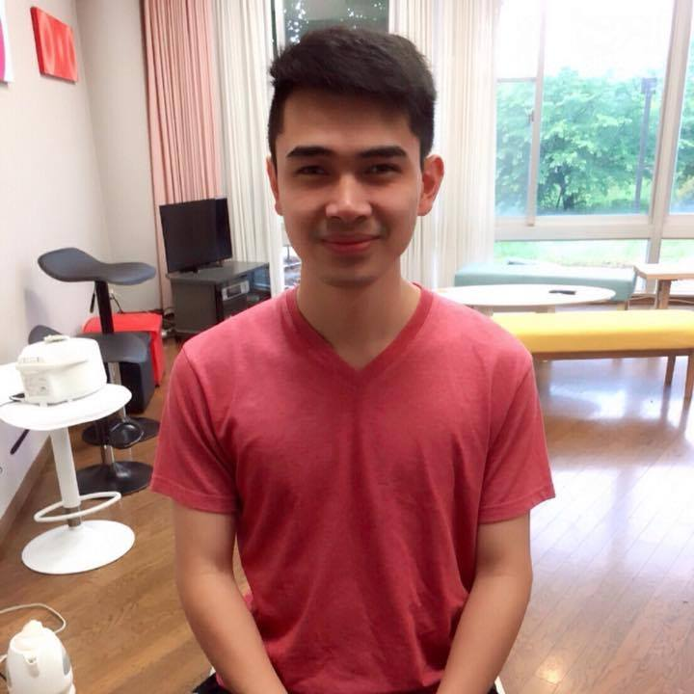
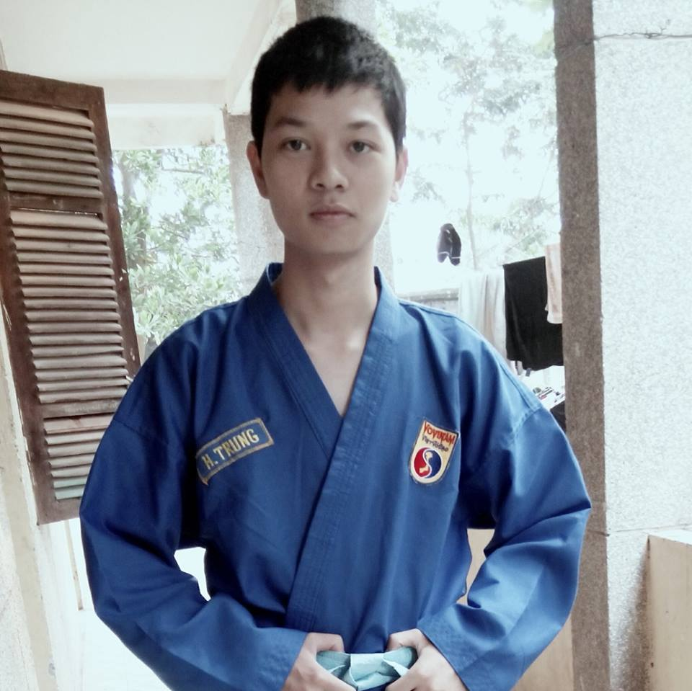
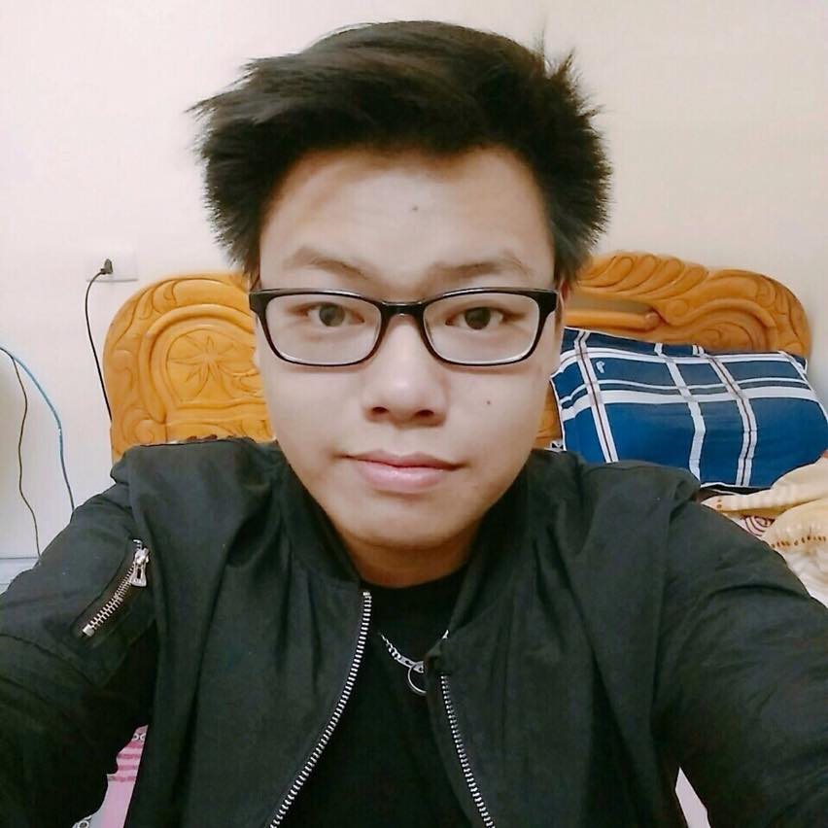
About Us
- PSM Team -
We are a group of 5 FPT University students. Under the supervision of Prof. Phan Truong Lam, we have finished this capstone project.
Phan Truong Lam
Supervisor
Cao Lam Vu
Member
Nguyen Sy Bach
Member
Nguyen Manh Huy
Leader
Nguyen Hoang Trung
Member
Pham Tuan Dung
Member

Slide 4
Outline アウトライン
1. Introduction イントロダクション
2. Software Project Management プロジェクト管理
3.Software Requirement Specification ソフトウェア要件仕様書
4. Software Design Description ソフトウェア 設計書
5. Software Testing ソフトウェアテスト
6. Lesson Learn 学んだ教訓
7. Demo デモ
8. Q & A 質問と回答

Slide 5

INTRODUCTION イントロダクション

Slide 6

About Our Project
INTRODUCTION

Slide 7

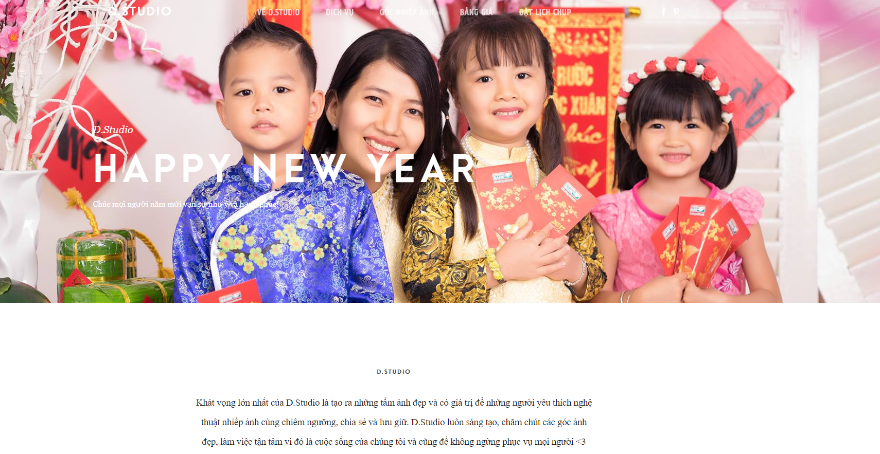
Existing system
INTRODUCTION
Donald Studio (http://donaldstudio.net)
D Studio (http://dstudio.vn)

Slide 8

Idea
INTRODUCTION
“Photographic Studio Manager” is a brand new website systems that include management systems for both managers and customers.

Slide 9

PROJECT MANAGEMENT プロジェクト管理

Slide 10
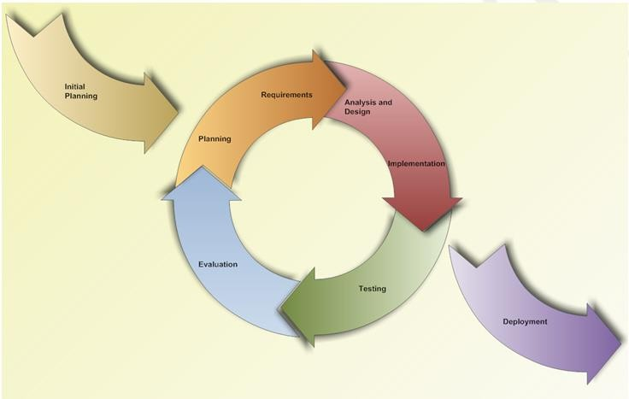
Software development process フトウェア開発のプロセス
PROJECT MANAGEMENT
Iteration 1: Jan 11th – Apr 13th

Slide 11
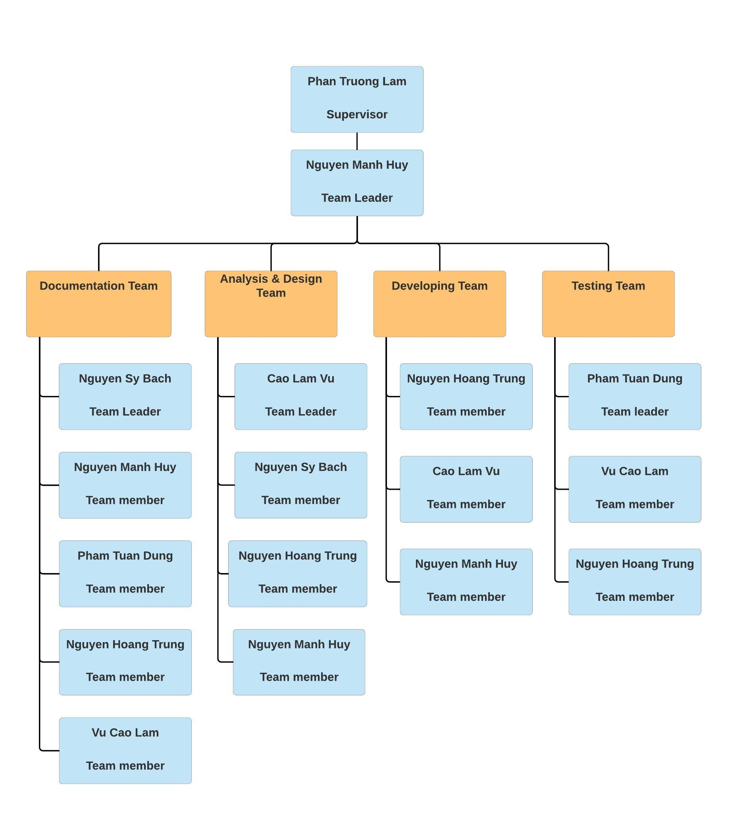
Organizational Structure - 組織構造
PROJECT MANAGEMENT

Slide 12
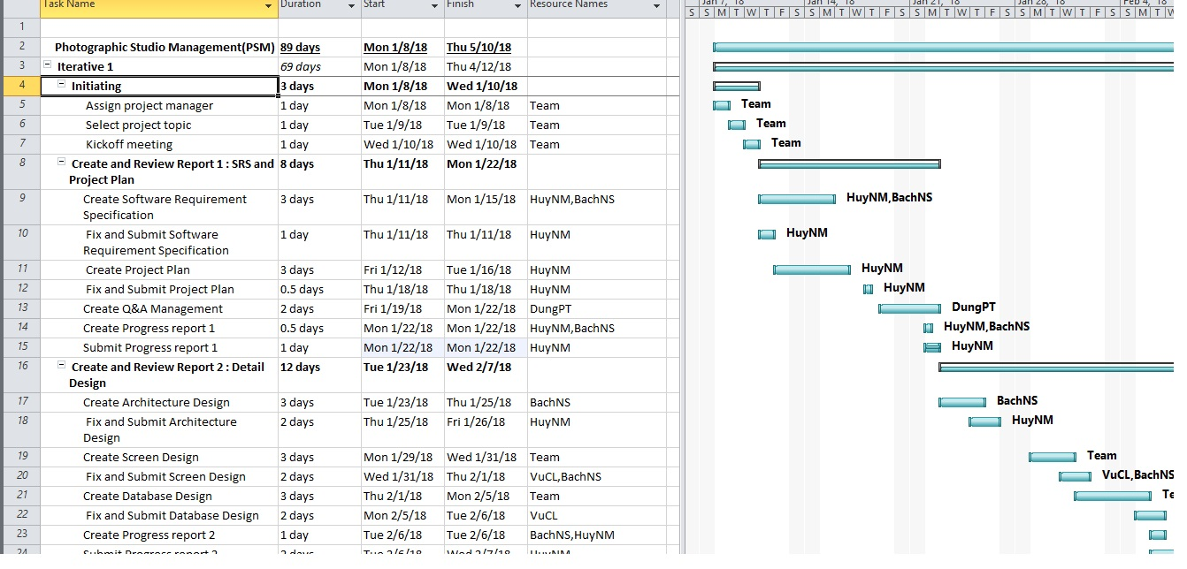
Project Schedule - プロジェクトスジュール
PROJECT MANAGEMENT

Slide 13




Project Tools – プロジェクトツール
PROJECT MANAGEMENT
Tools for project management
DROPBOX

Slide 14




Project Tools – プロジェクトツール
PROJECT MANAGEMENT
Tools for developing
Visual Studio Code
Webstorm
Google Chrome
Lucidchart

Slide 15
Risk Management - リスク管理
PROJECT MANAGEMENT
No | Name | Root Cause | Probability | Avoidance plan | Contingency plan | Impact
1 | Team don’t keep the deadline on time. | Members lack of responsibility, sick. Lack of management. | Medium | Make rules and penalties for people who doesn’t meet the deadline. | Working overtime to complete on time | High
2 | Requirement changed while project is processing. | SRS is not provide all information about user requirement such as: lack of customer’s requirement, misunderstand requirement of customer. | High | SRS should be review carefully by PM and the Supervisor. Hold all meeting and make minimize effort to change and improve design by requirement changes. | Team members will have meetings with supervisor to analyze the requirement change, and make a specific action to resolve that problem. | High
3 | Delivery does not meet the deadline. | Team member work late, sick or have other family business | High | Assign tasks to suitable team members depending on their strengths and weakness. | Team leader should regularly care about deadline and project schedule to inform members. Break down task to smaller tasks and assign new tasks to team members. | Medium
4 | Lack of knowledge about technology needs for project. | With some member, they lack the knowledge of new technology for doing the assign task. | Medium | Each team member must study to understand the technology, framework, which is needed for project. | Take example form supervisor and self-study Review complete task to make comment for team member. | Medium
5 | Conflict among team members. | Team member doesn't understand each other. | Medium | Plan some games or team building activities to improve teammate’s relationship and to understand each other. Clear role and responsibility between members. | Have a meeting to resolve conflict problems. | High
6 | Data or Source Code Lost. | Delete Brand in GitHub. Delete wrong source code. | Medium | Back up source code carefully. Commit all small tasks after complete to GitHub. | Restore data from backed up data. Restore source code from history versions. | High

Slide 16




Communication management - コミュニケーション管理
PROJECT MANAGEMENT
Time: 7 hours/day, 5 days/week.
Location: Alpha building, room 105R, FPT University Hoa Lac.
Communication:
Supervisor meeting: Twice a week.

Slide 17

SOFTWARE REQUIREMENT SPECIFICATION ソフトウェア要件仕様書

Slide 18
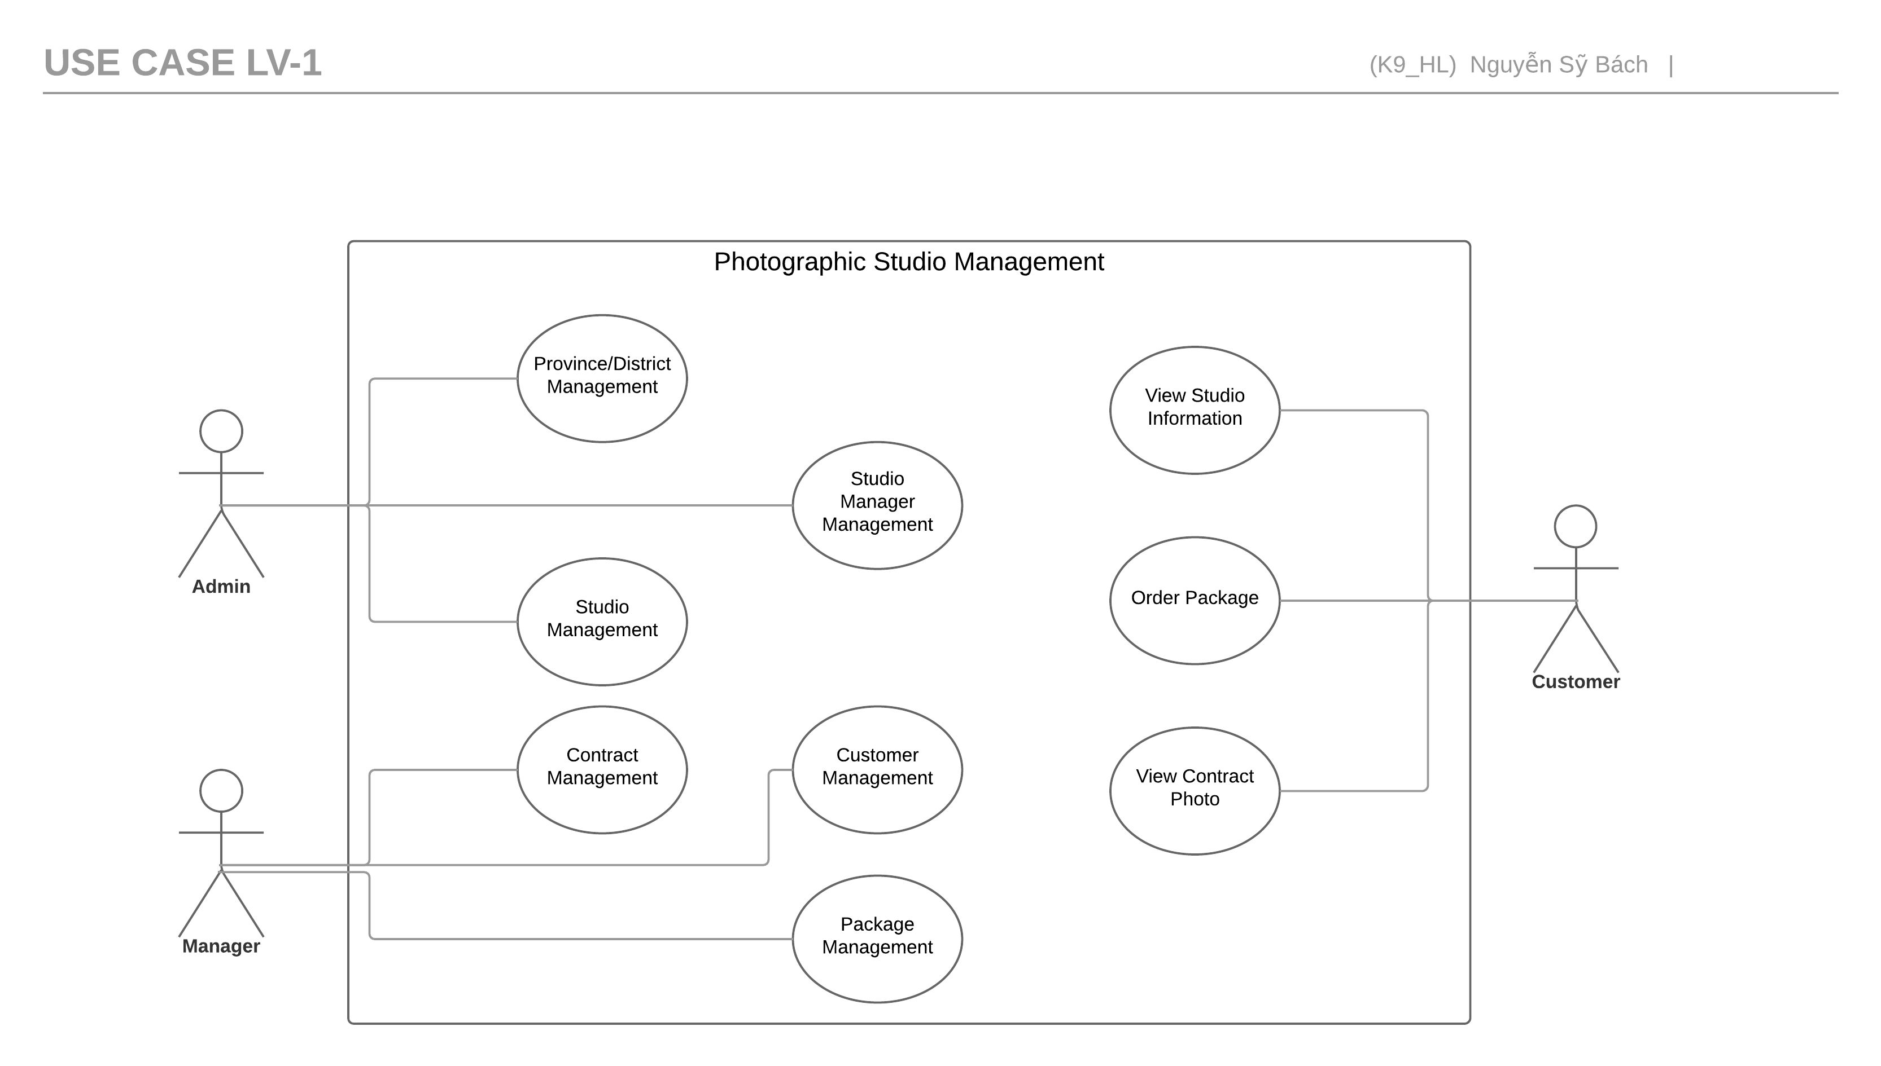
Use-cases overview:
Software Requirement Specification
Admin
Manager
Customer

Slide 19
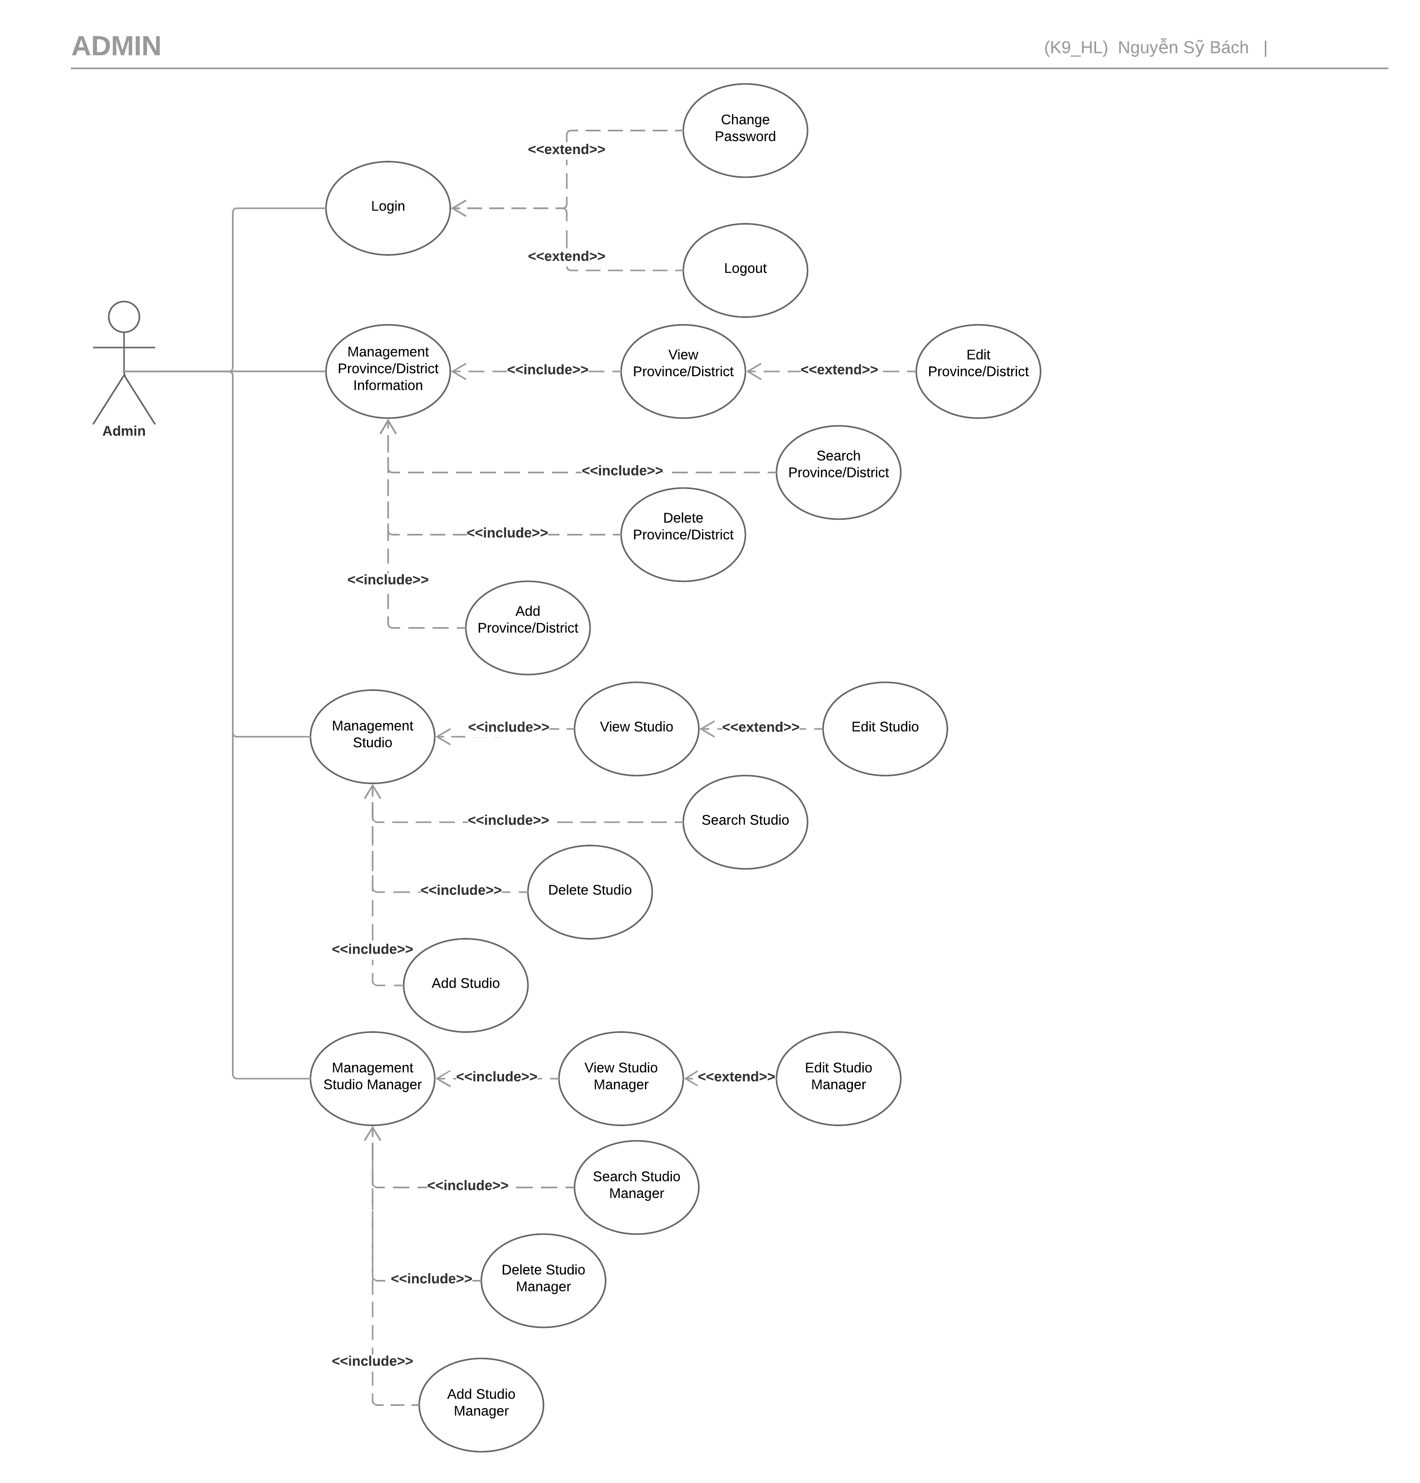

Admin
Software Requirement Specification

Slide 20
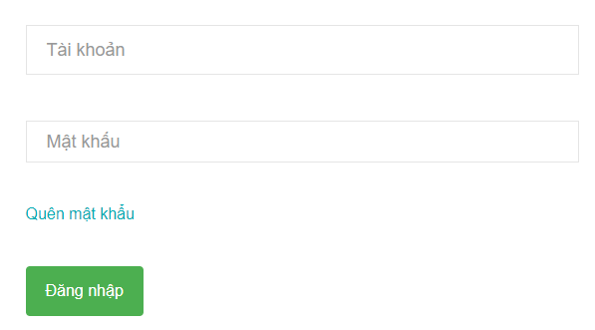
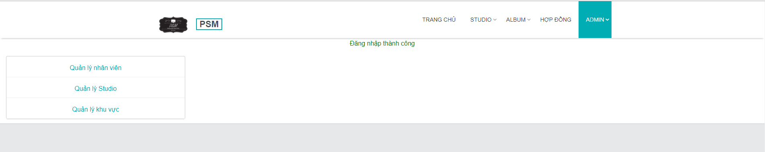
Software Requirement Specification
LOGIN PAGE
Admin
USER PAGE

Slide 21
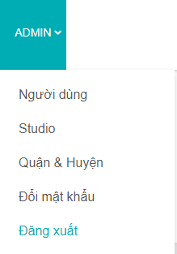
Software Requirement Specification
LOGIN PAGE
HEADER
Admin

Slide 22
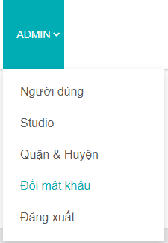
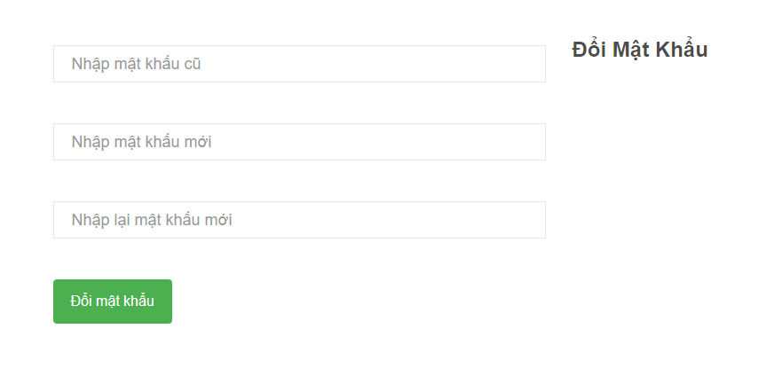
Software Requirement Specification
HEADER
CHANGE PASSWORD PAGE
Admin

Slide 23
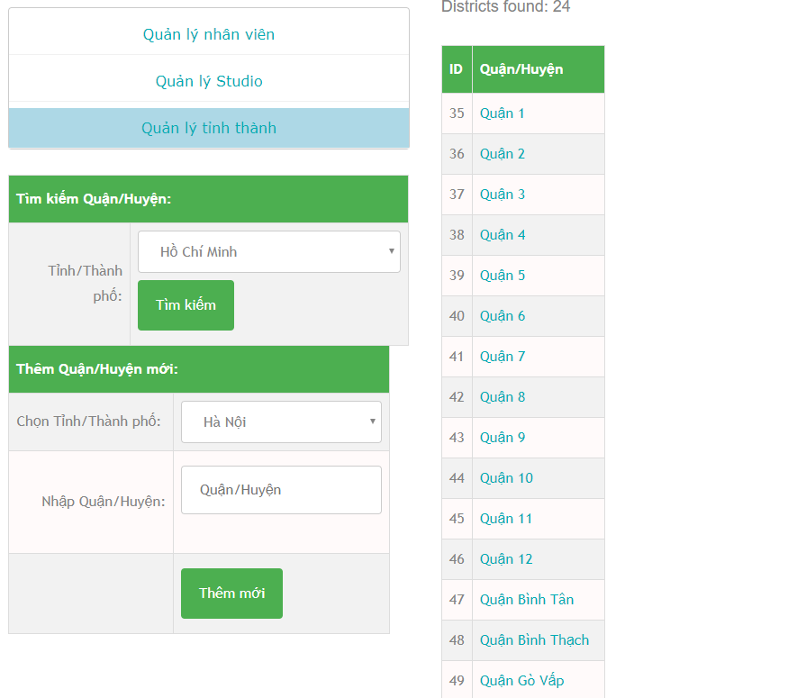
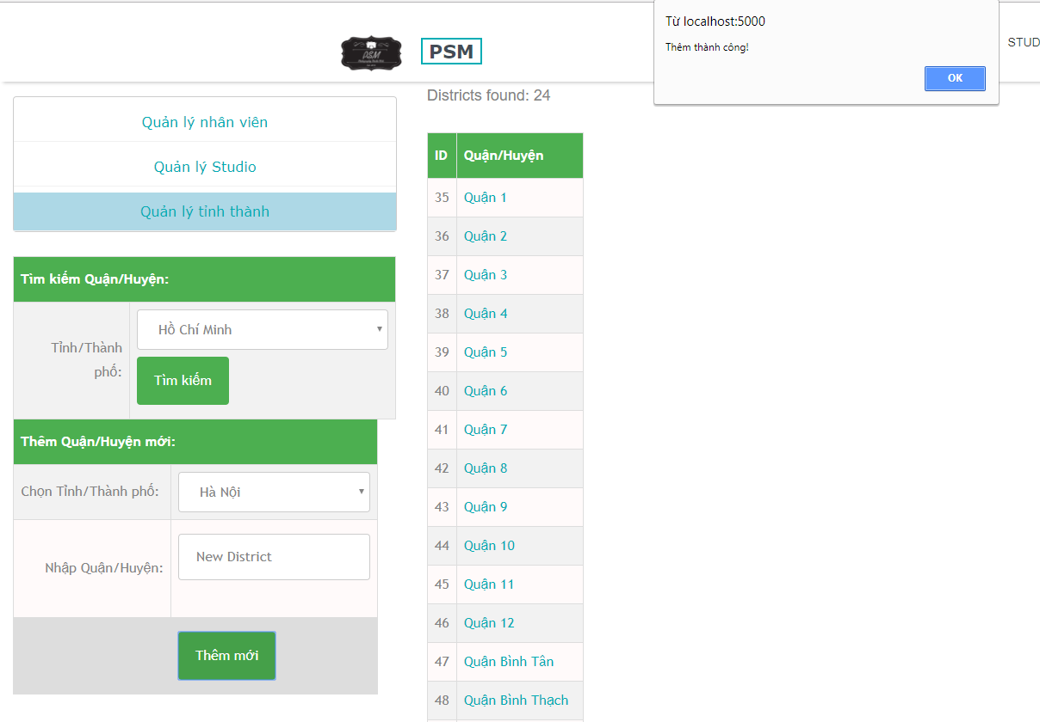
Software Requirement Specification
Admin
DISTRICT VIEW
Admin
DISTRICT ADD

Slide 24
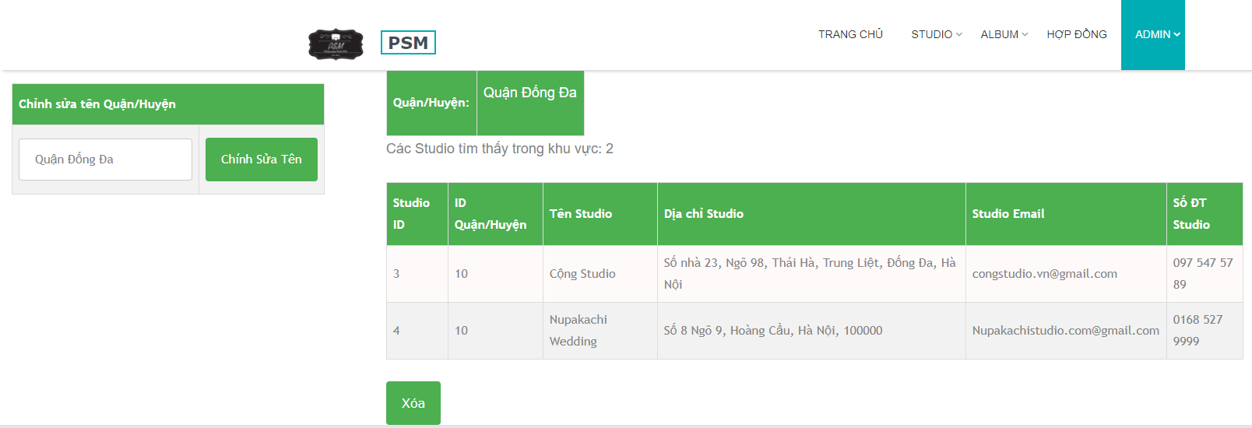
Software Requirement Specification
Admin
DISTRICT DETAIL VIEW

Slide 25
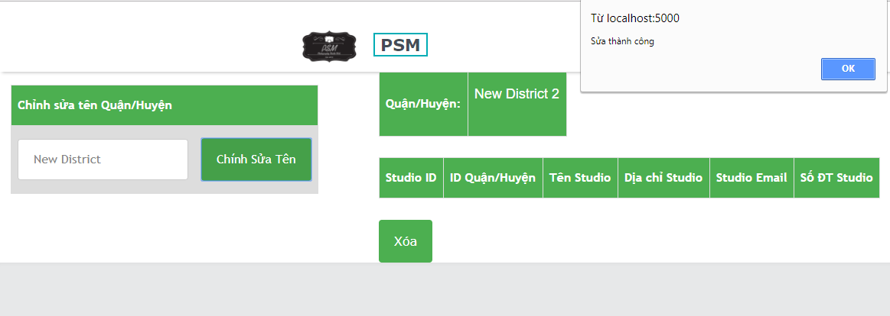
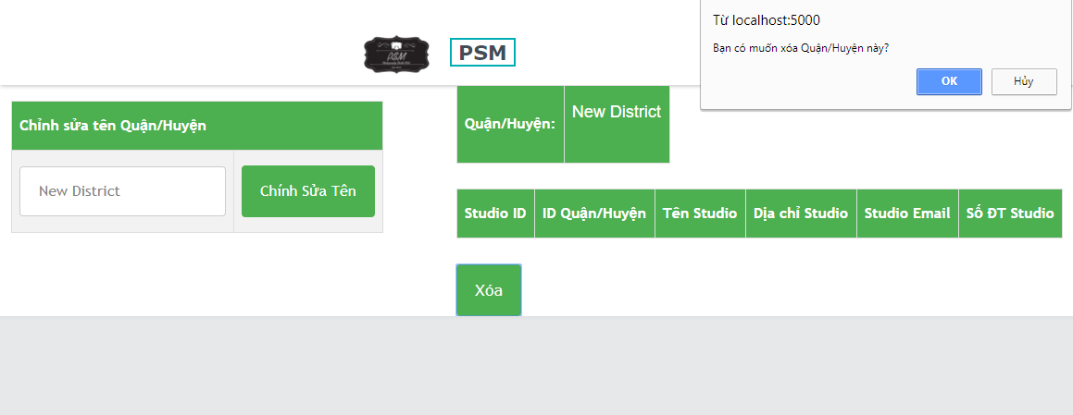
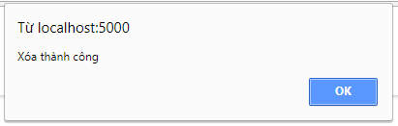
Software Requirement Specification
DISTRICT EDIT
Admin
DISTRICT DELETE

Slide 26
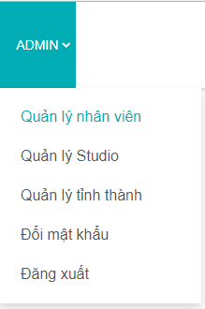
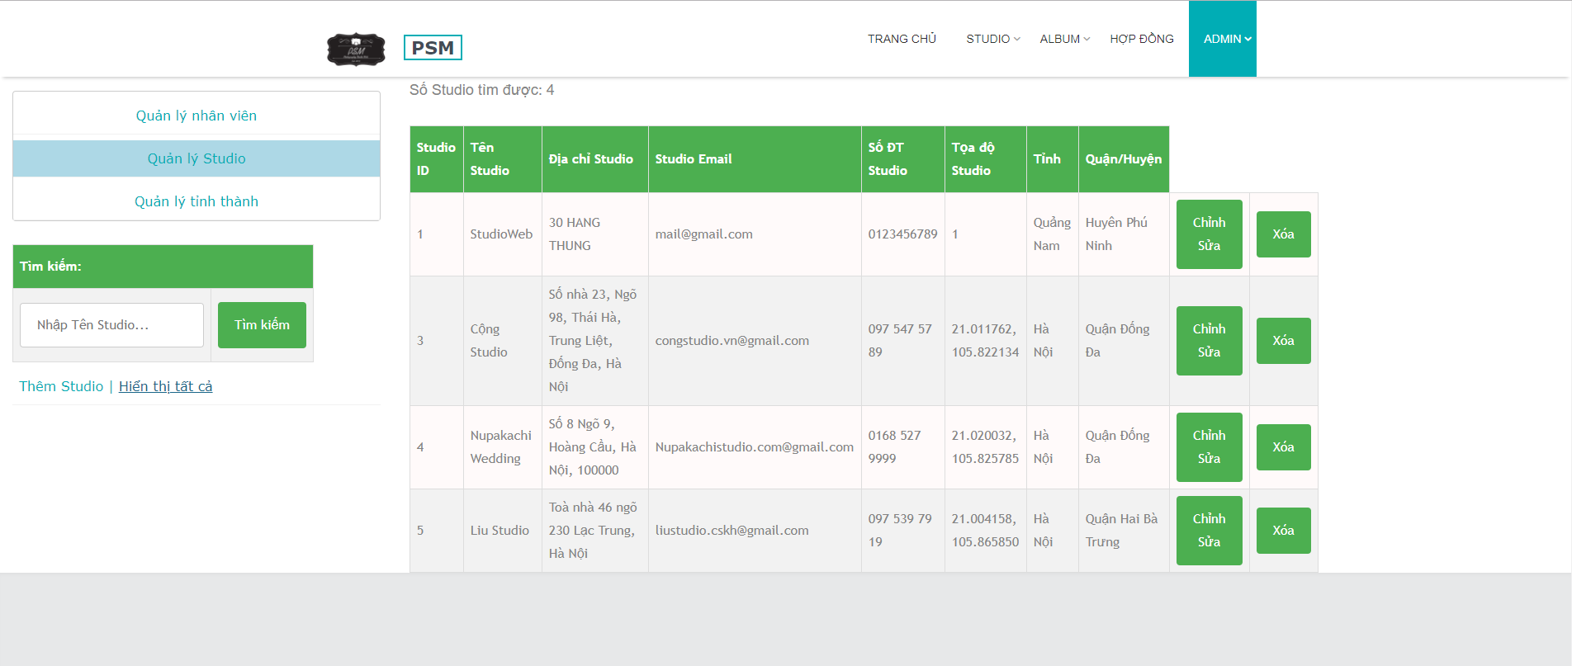
Software Requirement Specification
Admin
STUDIO PAGE

Slide 27
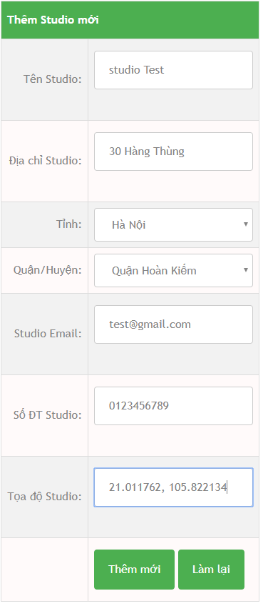
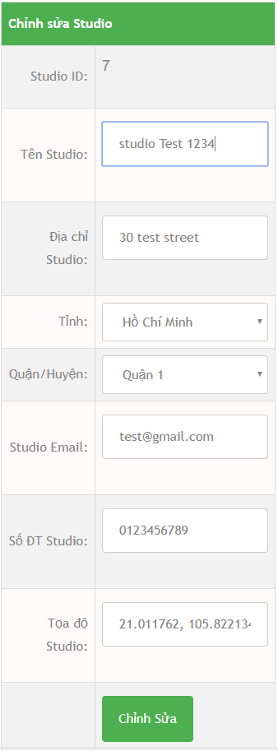
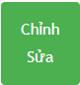
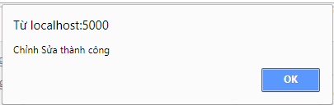
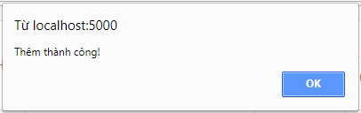
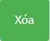
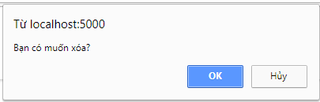
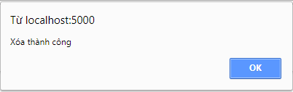
Software Requirement Specification
Admin
STUDIO ADD
STUDIO EDIT
STUDIO DELETE

Slide 28
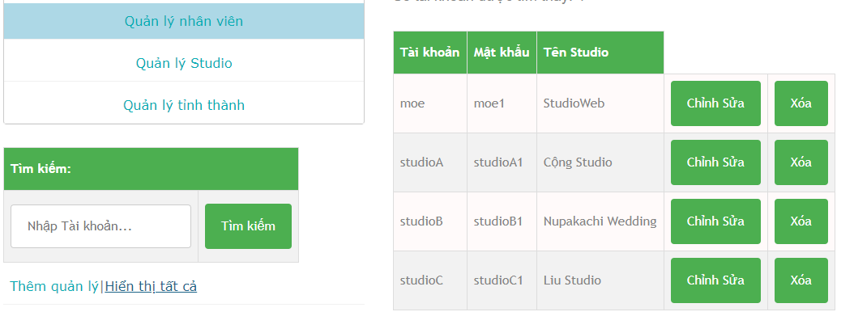
Software Requirement Specification
STUDIO MANAGER MANAGEMENT PAGE
Admin

Slide 29
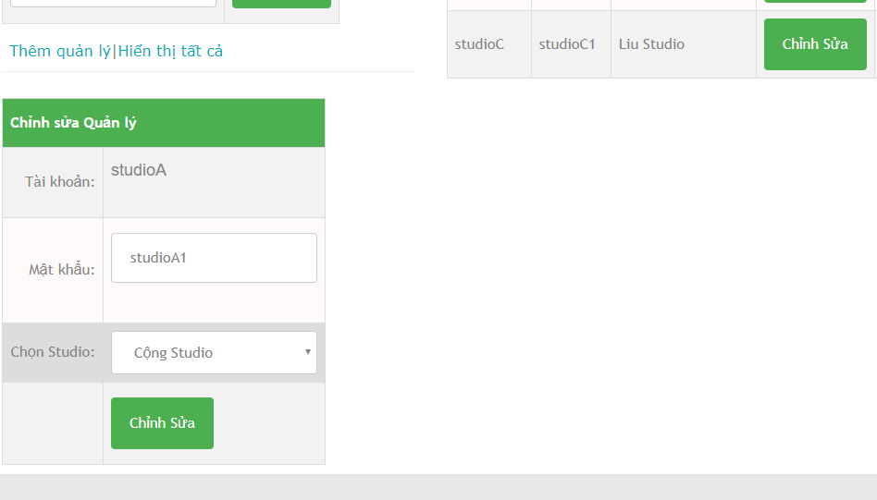
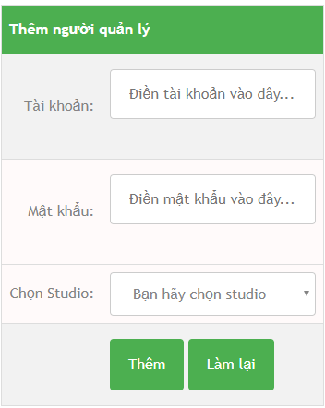
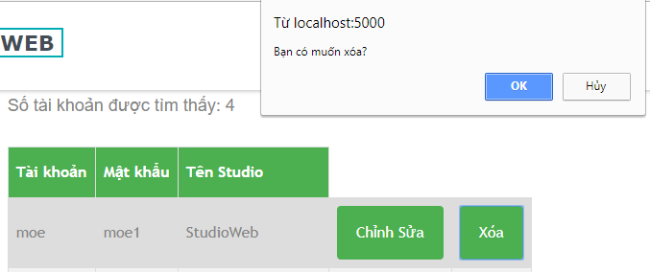
Software Requirement Specification
STUDIO MANAGER EDIT
STUDIO MANAGER ADD
Admin
STUDIO MANAGER DELETE

Slide 30
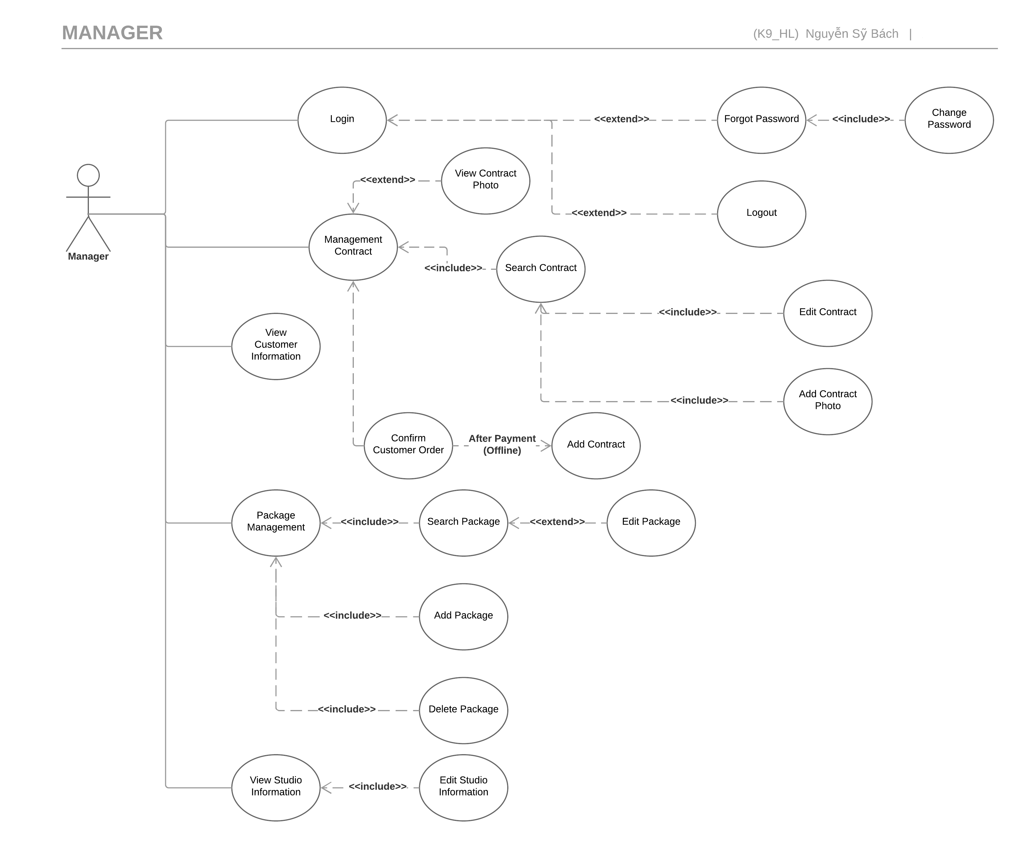
Manager
Software Requirement Specification

Slide 31
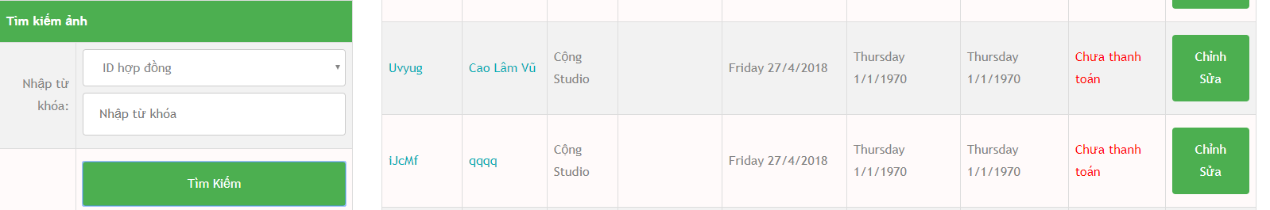
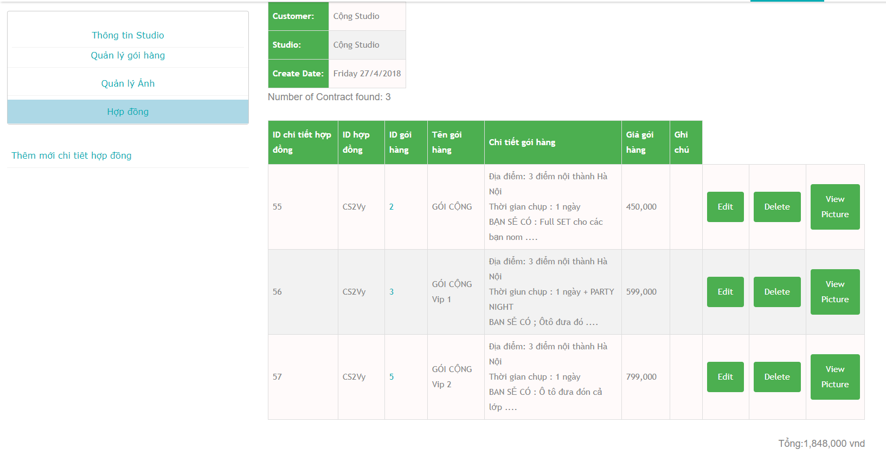
Software Requirement Specification
Manager
CONTRACT VIEW

Slide 32
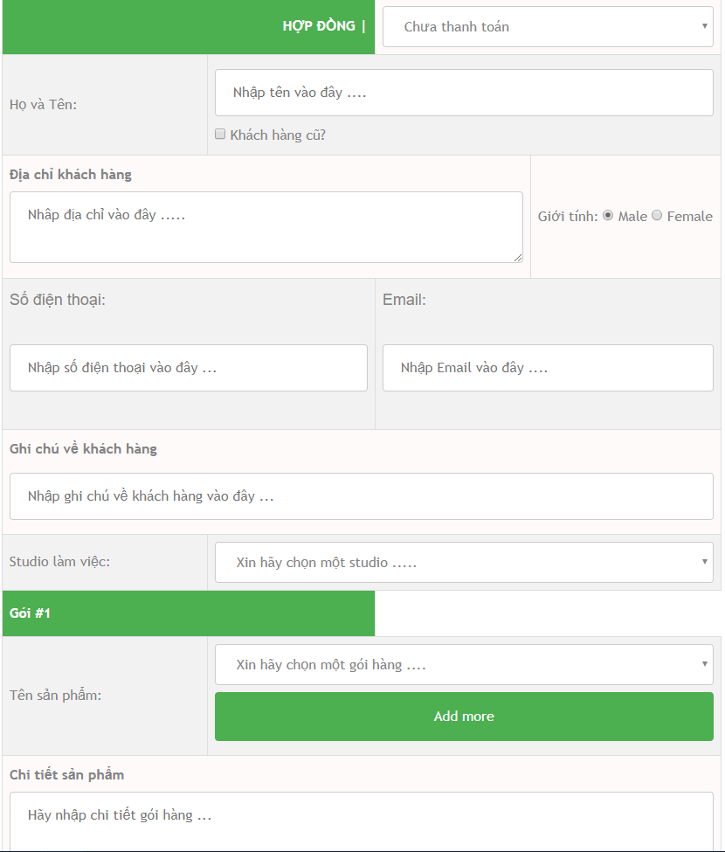
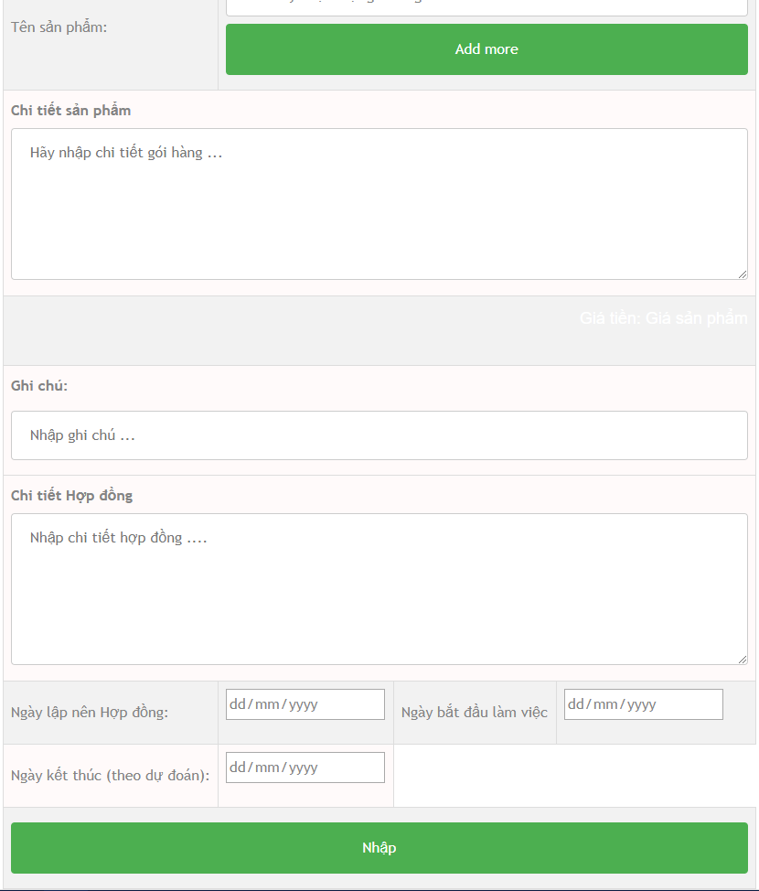
Software Requirement Specification
Manager
CONTRACT ADD

Slide 33
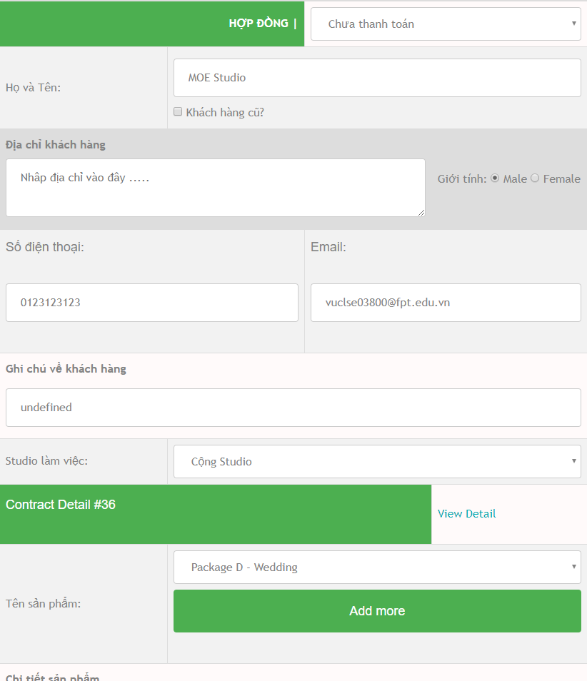
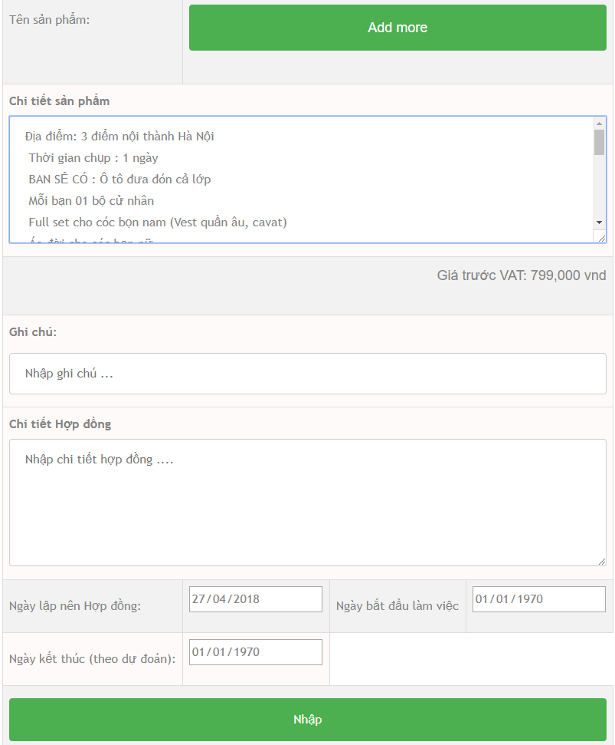
Software Requirement Specification
Manager
CONTRACT EDIT

Slide 34
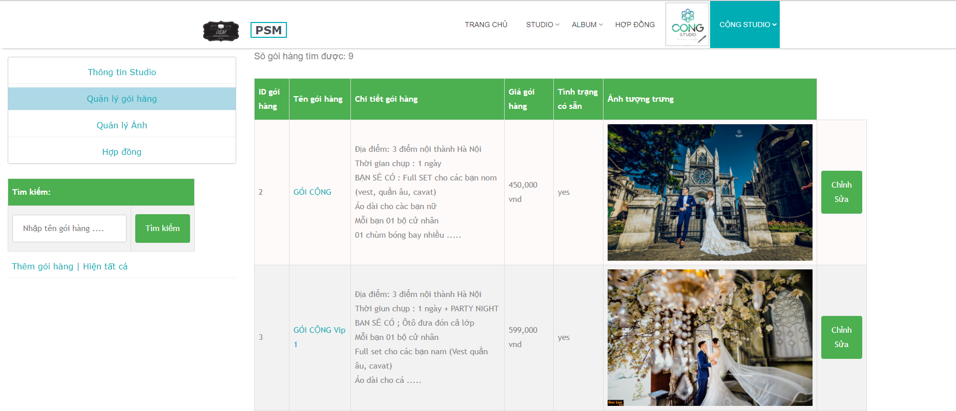
Software Requirement Specification
Manager
PACKAGE VIEW

Slide 35
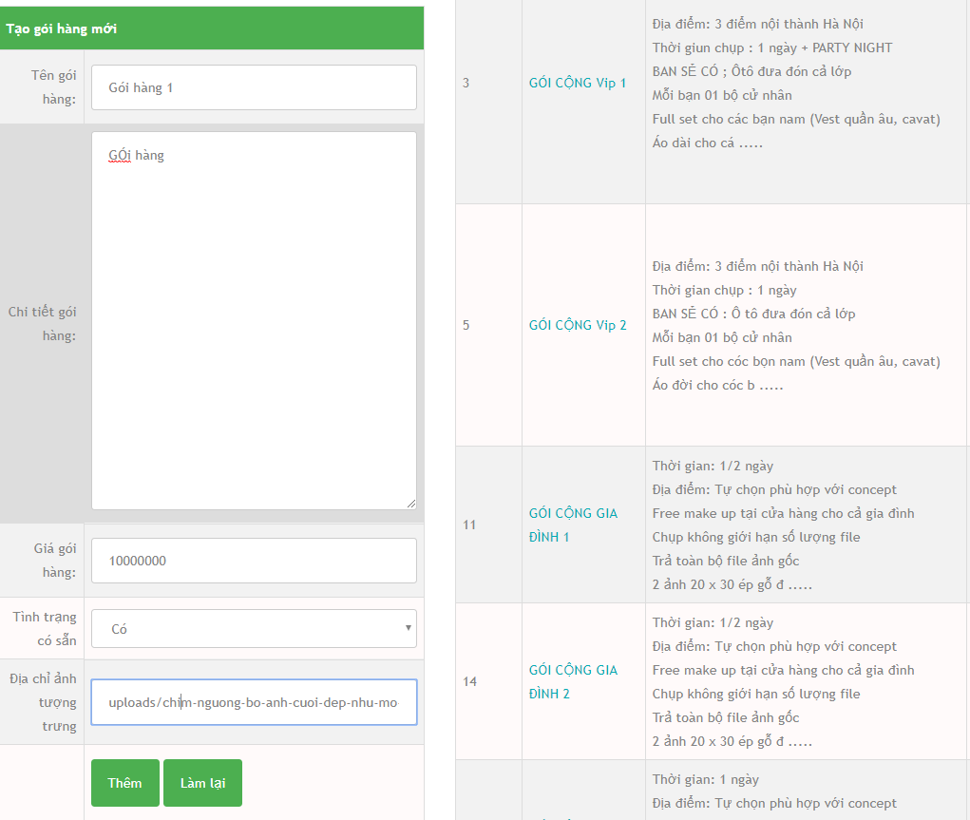
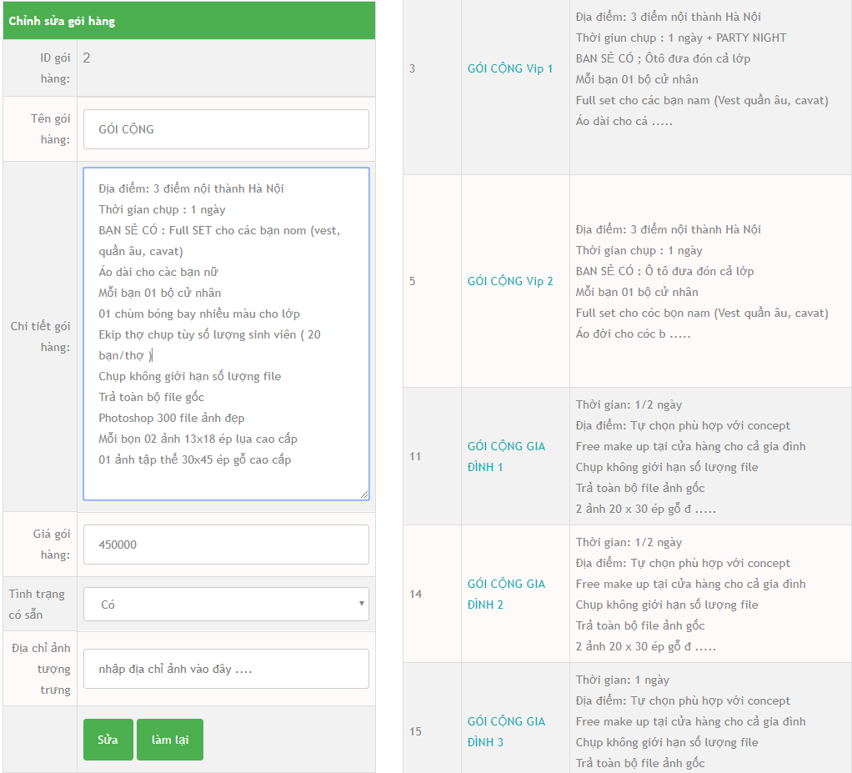
Software Requirement Specification
Manager
PACKAGE ADD
PACKAGE EDIT

Slide 36
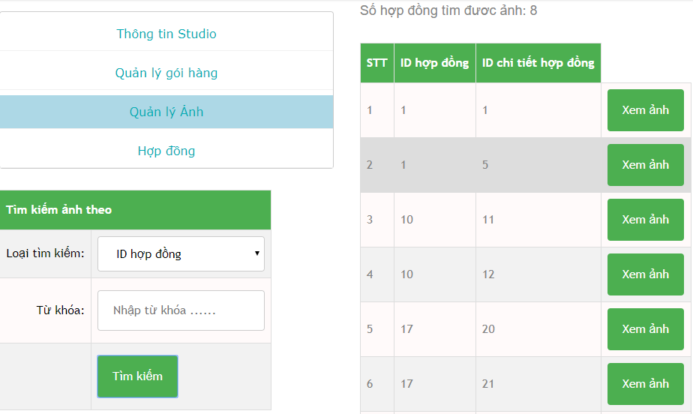
Software Requirement Specification
Manager
SEARCH PICTURE

Slide 37
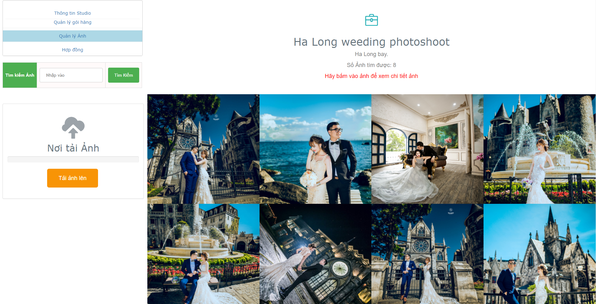
Software Requirement Specification
Manager
VIEW PICTURE

Slide 38
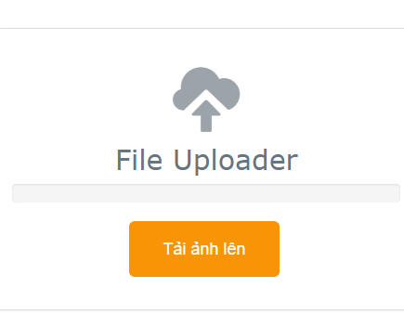
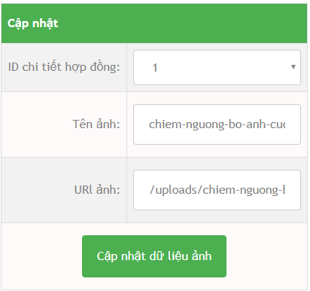

Software Requirement Specification
DELETE PICTURE
UPLOAD PICTURE
UPDATE PICTURE
Manager

Slide 39

Software Requirement Specification
Manager
VIEW CUSTOMER INFO

Slide 40


Software Requirement Specification
VIEW AND EDIT STUDIO PROFILE
Manager

Slide 41

Customer
Software Requirement Specification

Slide 42

Software Requirement Specification
Customer
HOME PAGE

Slide 43

Software Requirement Specification
Customer
STUDIO LIST PAGE

Slide 44

Software Requirement Specification
Customer
Studio Info page

Slide 45

Software Requirement Specification
Customer
Studio info page

Slide 46

Software Requirement Specification
Customer
Studio’s package info page

Slide 47


Software Requirement Specification
Studio info page
Customer
Checkout page

Slide 48

Software Requirement Specification
Customer
Customer’s Contract view page

Slide 49

Software Requirement Specification
Customer
Customer’s Contract view page

Slide 50

Non – Functional Requirement
Software Requirement Specification
Usability
Interface should be beauty, simple, easy-to-use, clear.
Provide an introduction to support users.

Slide 51

Non – Functional Requirement
Software Requirement Specification
Reliability
Search result return must be correctly.
Use’s information must be reliable.
The database must be backed up daily and can be recovered if necessary.

Slide 52

Non – Functional Requirement
Software Requirement Specification
Maintainability
The output of the project must include naming conventions documentations.
Code implementation must be easy to maintain.

Slide 53

Software Requirement Specification
Entity Relationship Diagram

Slide 54

SOFTWARE DESIGN DESCRIPTION ソフトウェア要件仕様書

Slide 55





Technology & Description
Front End
Back End
SOFTWARE DESIGN DESCRIPTION

Slide 56

System overview
SOFTWARE DESIGN DESCRIPTION
System Overview Diagram システムの概要

Slide 57

Component diagram
Component Design
SOFTWARE DESIGN DESCRIPTION

Slide 58

SQL DATABASE DESIGN
SOFTWARE DESIGN DESCRIPTION

Slide 59

Class diagram
Add Package Class Diagram
SOFTWARE DESIGN DESCRIPTION

Slide 60

Sequence diagram
Add Package Sequence Diagram
SOFTWARE DESIGN DESCRIPTION

Slide 61

SOFTWARE TESTING ソフトウェアテスト

Slide 62


SOFTWARE TESTING
Test Plan
Test Case
Test Report

Slide 63

SOFTWARE TESTING
Test Plan
Testing Strategy
Test stage:
Test type:
Unit Test
Integration test
System test
Function test
GUI test

Slide 64



Testing Environment and Tools
SOFTWARE TESTING
Test Plan
Microsoft Windows 10 Professional 64 bit
Google Chrome
Microsoft Office Word, Excel 2007

Slide 65


SOFTWARE TESTING
Test Plan
Testing Environment and Tools
Chaijs V3.5.0
Mocha v2.4.5

Slide 66

SOFTWARE TESTING
Test Case
Integration Test

Slide 67

SOFTWARE TESTING
Test Case
System Test

Slide 68

SOFTWARE TESTING
Test Report
Unit Test Report

Slide 69

SOFTWARE TESTING
Test Report
Integration Test Report

Slide 70

SOFTWARE TESTING
Test Report
System Test Report

Slide 71

SOFTWARE TESTING
Test Report
Test Report

Slide 72

Lesson Learn - 学んだ教訓

Slide 73






Management Skill
New Technology
Teamwork
Requirements analysis
Writing Document Skill

Slide 74

Demo
____________________
デモ

Slide 75

____________________
質問と回答
Q&A
Questions & Answers
__________________

Slide 76

THANK YOU
FOR YOUR ATTENTION
We would like to express our gratitude for our teachers and specialy our supervisor Mr.Phan Truong Lam
ご清聴でありがとうございます。

